Slide 1

AHA Clinical Slide Series
ADAPTED FROM:
The 2023 Scientific Statement From the AHA:
A Synopsis of the Evidence for the Science and Clinical Management of Cardiovascular-Kidney-Metabolic Syndrome
AHA Clinical Slides PPTX

Slide 2
Definition of
Cardiovascular-Kidney-Metabolic Syndrome (CKM)
A systemic disorder characterized by pathophysiologic interactions among metabolic risk factors, chronic kidney disease, and the cardiovascular system, leading to multi-organ dysfunction and a high rate of adverse cardiovascular outcomes.
CKM syndrome includes both individuals at risk for cardiovascular disease due to the presence of metabolic risk factors and/or chronic kidney disease, and individuals with existing cardiovascular disease that is potentially related to or complicates metabolic risk factors and/or chronic kidney disease.
The increased likelihood of CKM syndrome and its adverse outcomes is further influenced by unfavorable conditions for lifestyle and self-care resulting from policies, economics, and the environment.
Abbreviations: CKM indicates Cardiovascular-Kidney-Metabolic.
Ndumele, C.E. et al., A Synopsis of the Evidence for the Science and Clinical Management of Cardiovascular-Kidney-Metabolic Syndrome: A Scientific Statement From the American Heart Association. 2023. Circulation.

Slide 3
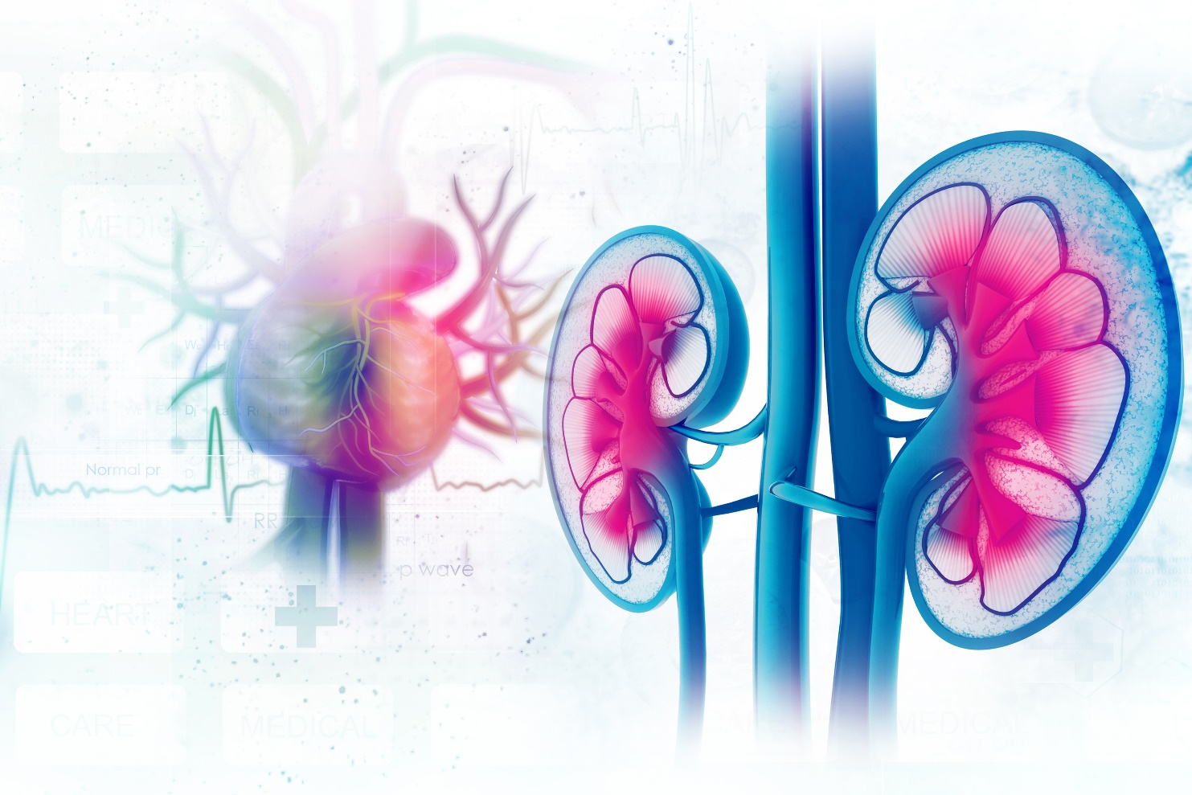
Definition of CKM Syndrome Simplified
Cardiovascular-kidney-metabolic (CKM) syndrome
is a health disorder due to connections among heart disease, kidney disease, diabetes, and obesity leading to poor health outcomes.
Abbreviations: CKM indicates Cardiovascular-Kidney-Metabolic.

Slide 4
Conceptual Diagram of the CKM Syndrome​
Abbreviations: CKM indicates Cardiovascular-Kidney-Metabolic; and MASLD, metabolic dysfunction-associated steatotic liver disease.

Slide 5
Scientific Understanding of CKM Syndrome ​
Mechanisms of end-organ injury are hemodynamic, metabolic, inflammatory,
and fibrotic.
CKM syndrome results in excess morbidity and mortality beyond the sum of its parts.
Metabolic risk factors cause end-organ damage in the heart, kidneys, and vasculature.
Abbreviations: CKM indicates Cardiovascular-Kidney-Metabolic.

Slide 6






Scientific Understanding of CKM Syndrome
Chronic Kidney Disease as an Amplifier of Cardiovascular Risk
Low glomerular filtration rate and albuminuria independently increase the risk of MACE and CV death
Pro-inflammatory state which potentiates CVD risk
Development of heart failure and/or progressive CKD can increase bidirectional organ damage, in tandem with neurohormonal activation and inflammation
CKD and diabetes precipitate peripheral artery disease below the knee
Vascular calcification is common in CKD and increases CVD risk
Anemia is common in CKD and exacerbates CVD
Abbreviations: CKD indicates chronic kidney disease; CKM, Cardiovascular-Kidney-Metabolic; CV, cardiovascular;
CVD, cardiovascular disease; and MACE, major adverse cardiovascular events.

Slide 7




Key Gaps in the Scientific Understanding of CKM Syndrome
Mechanisms
of CVD development in CKM Syndrome
Understanding the Heterogeneity within CKM Syndrome
Need for Longitudinal Studies of Competing Risk
Understanding Bidirectional Cardiovascular-Kidney Relationships
Abbreviations: CKM indicates Cardiovascular-Kidney-Metabolic; and CVD, cardiovascular disease.

Slide 8
Key Gaps in the
Scientific Understanding of CKM Syndrome
A Socioecological
Framework for
CKM Syndrome
Abbreviations: CKM indicates Cardiovascular-Kidney-Metabolic.
Ndumele, C.E. et al., A Synopsis of the Evidence for the Science and Clinical Management of Cardiovascular-Kidney-Metabolic Syndrome: A Scientific Statement From the American Heart Association. 2023. Circulation.

Slide 9
Key Gaps in Screening Approaches for CKM Syndrome
Early Life Screening
Screening for Metabolic Risk Factors and CKD in Adults
Subclinical CVD Diagnosis
SDOH Screening
Abbreviations: CKD indicates chronic kidney disease; CKM, Cardiovascular-Kidney-Metabolic; CVD, cardiovascular disease; SDOH, social determinants of health.

Slide 10
CKM Syndrome Staging Definitions
Stage 0
Stage 1
Stage 2
Stage 3
Stage 4
Stage 1
Stage 4
No CKM Risk Factors
Excess or Dysfunctional Adiposity
Metabolic Risk Factors or CKD
Subclinical CVD in CKM Syndrome
Clinical CVD in CKM Syndrome
Stage 4a: - Kidney Failure
Stage 4b:+ Kidney failure
Abbreviations: CKD indicates chronic kidney disease; CKM, Cardiovascular-Kidney-Metabolic; and CVD, cardiovascular disease.

Slide 11
Evidence for Prevention and Management in CKM Syndrome
Stage 0
Stage 1
Abbreviations: BP indicates blood pressure; CVH, cardiovascular health; CVD, cardiovascular disease CKD, chronic kidney disease;
CKM, Cardiovascular-Kidney-Metabolic; CVD, cardiovascular disease; and CVH, cardiovascular health.

Slide 12
Evidence for Prevention and Management in CKM Syndrome
Stage 2
Stage 3
Abbreviations: ACEi indicates angiotensin-converting-enzyme inhibitors; ARB, angiotensin II receptor blockers; ASCVD, atherosclerotic cardiovascular disease; BP, blood pressure; CAC, coronary artery calcium; CKD, chronic kidney disease; CKM, cardiovascular-kidney-metabolic; CVD, cardiovascular disease; eGFR, estimated glomerular filtration rate; HbA1c, hemoglobin A1c; HF, heart failure; LDL-C, low-density cholesterol; LV, left ventricle; MACE, major adverse cardiac event; MetS, metabolic syndrome; and SGLT2i, sodium-glucose cotransporter-2 inhibitor.

Slide 13
Evidence for Prevention and Management in CKM Syndrome
Stage 4
Abbreviations: ACEi indicates angiotensin-converting-enzyme inhibitors; ARB, angiotensin II receptor blockers; ARNi, angiotensin receptor/neprilysin inhibitors; ASCVD, atherosclerotic cardiovascular disease; BP, blood pressure; CKD, chronic kidney disease; CKM, cardiovascular-kidney-metabolic; CV, cardiovascular; CVD, cardiovascular disease; eGFR, estimated glomerular filtration rate; GDMT, guideline-directed medical therapy; GLP-1RA, glucagon-like peptide 1 receptor agonist; HbA1c, hemoglobin A1c; HF, heart failure; HFpEF, heart failure with preserved ejection fraction; HFrEF, heart failure with reduced ejection fraction; LDL-C, low-density cholesterol MACE, major adverse cardiac event; MRA, mineralocorticoid receptor antagonist; P2Y12i, P2Y12 inhibitor; SGLT2i, sodium-glucose cotransporter-2 inhibitor; and QOL, quality of life.

Slide 14
Prevention and Management in CKM Syndrome
Gaps in the Evidence
Use of Cardioprotective antihyperglycemics with diabetes
at-risk for CVD
Strategies to Support Weight Loss
Interdisciplinary
Care Approach
Early Life Prevention
Use of Cardioprotective antihyperglycemics with diabetes and existing CVD
Use of non-statin lipid lowering agents with diabetes and high CKM risk
Management of CVD in Patients with CKD
Abbreviations: CKM indicates Cardiovascular-Kidney-Metabolic; and CVD, cardiovascular disease.

Slide 15
Citation:
The American Heart Association requests this electronic slide deck be cited as follows:
Reyna, G.G. (2023). AHA Clinical Slides [PowerPoint slides]; Adapted from the 2023 Scientific Statement From the AHA: A Synopsis of the Evidence for the Science and Clinical Management of Cardiovascular-Kidney-Metabolic Syndrome. Circulation. Retrieved from:
Guideline Essentials: AHA Clinical Slide Series - Professional Heart Daily | American Heart Association.
Ndumele, C.E. et al., A Synopsis of the Evidence for the Science and Clinical Management of Cardiovascular-Kidney-Metabolic Syndrome: A Scientific Statement From the American Heart Association. 2023. Circulation.

Slide 16
Copyright and Permissions Notice
© Copyright 2025. American Heart Association. All rights reserved.
This material is the copyrighted property of the American Heart Association and is provided for reference purposes only. It may not be copied, reproduced, stored in a retrieval system, transmitted, altered in any way or used as a derivative work, or distributed in any form or by any means—electronic, mechanical, photocopying, recording, or otherwise—without prior written permission from the publisher.
This content may be used for limited educational and personal use. Further distribution or dissemination requires a licensing agreement. Unauthorized use or distribution in any media is strictly prohibited.
For permissions inquiries and licensing fee information, please see the information/Request Form at this link:
https://www.heart.org/en/about-us/statements-and-policies/copyright-request-form

